Slide 1

QDOCTOR
Your AI Compliance Co-pilot for Mental Healthcare.
The Right Answer, Right Now. Every Time.

Slide 2
Mental Healthcare is in a Dual Crisis.
Practitioner Burnout
Compliance Risk
78% of mental health professionals report moderate to severe burnout.
The average practitioner spends 6-8 hours per week on non-clinical administrative tasks.
Result: Less time for patients, higher staff turnover, and a system stretched to its breaking point.
A single compliance mistake can lead to license suspension, lawsuits, and patient harm.
Regulatory documents are dense, constantly updated, and spread across multiple sources.
Result: Fear, decision-paralysis, and a constant, low-level anxiety that undermines clinical confidence.
Our healers are burning out, crushed by a system that demands the impossible. We are losing our best practitioners to administrative burdens, not clinical challenges.

Slide 3

Human Cost
Meet Dr. Adan: A Dedicated Clinical Psychologist
Based in Nairobi, serving 150+ active patients
Manages a small team, driven by a passion for quality care
Faces a hidden workload that steals time from patient care
The Challenges Dr. Adan Faces
Complex Compliance: Navigating mandatory reporting for a suicidal teenage client under the latest Kenyan Mental Health Act
Data Privacy Concerns: Ensuring a new teletherapy platform meets patient confidentiality standards
Insurance Coding Errors: Correctly coding assessments to avoid rejected claims
The Problem
Hours spent searching dense PDFs, outdated websites, and consulting costly lawyers
Time lost that could be dedicated to improving patient outcomes

Slide 4
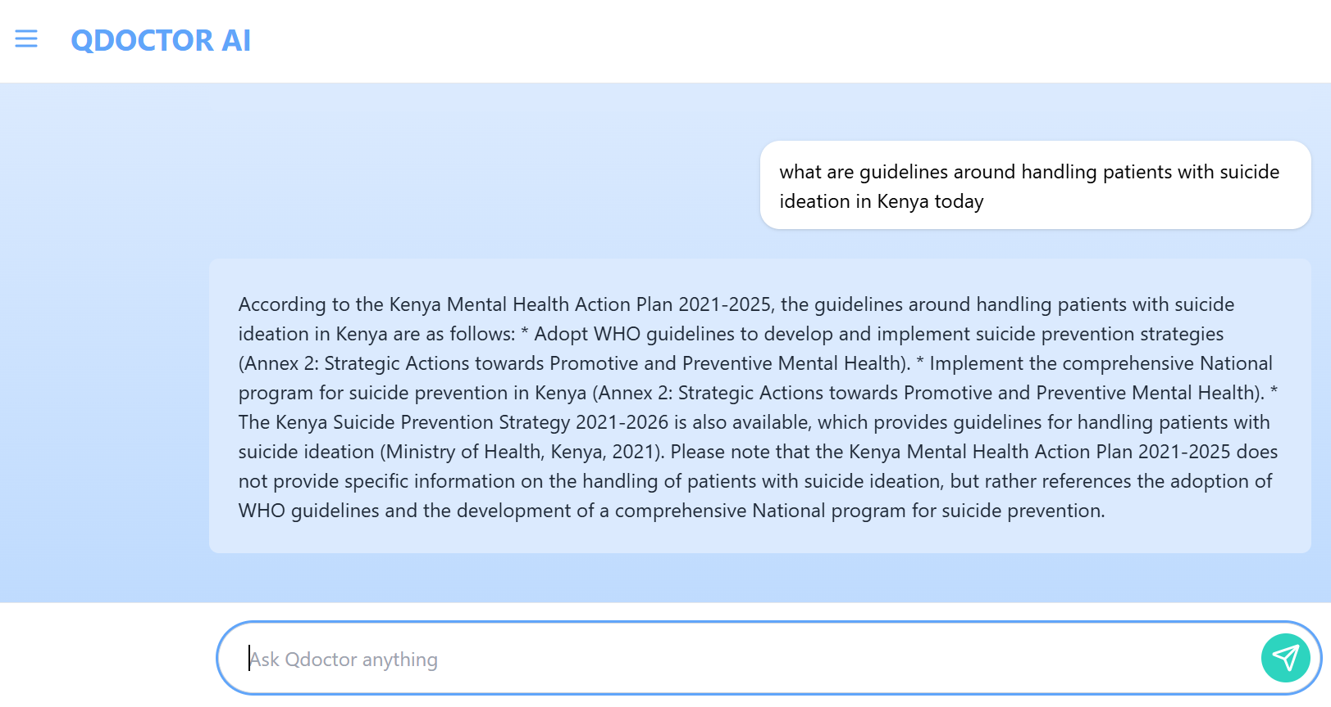
The Solution
The AI Compliance Co-pilot for Mental Health Professionals.
QDOCTOR is a specialized, conversational AI agent that provides instant, verifiable answers to complex questions about ethical codes, government procedures, and clinical guidelines.
No more searching. No more guessing.
Just ask a question in plain language and get a direct answer, cited back to the source document.
We transform regulatory complexity into clinical confidence.

Slide 5
From Question to Confident Action in Seconds.
1. ASK
2. VERIFY
3. ACT
Dr. Adan asks QDOCTOR a natural language question, just like talking to an expert colleague.
Our specialized AI instantly queries its curated knowledge base of official regulations, ethical codes, and procedural manuals.
QDOCTOR delivers a precise, actionable answer with a direct link to the source for ultimate verification and peace of mind.
Our "secret sauce" is the curated, country-specific data layer. Unlike generalist AIs,
our answers are not just probable—they are provable.

Slide 6
Why Now? The Perfect Storm
The Market is at a Critical Inflection Point.
Three powerful forces are converging to create an unprecedented opportunity.
Mental Health Crisis: Post-pandemic demand has skyrocketed, creating immense pressure on a limited workforce. Efficiency is no longer a luxury; it's a necessity for survival.
The AI Revolution: Clinicians are now actively seeking technology that works for them. The adoption curve for credible, specialized AI tools is accelerating dramatically.
Regulatory Burden: As mental healthcare becomes more formalized, the complexity of compliance is increasing exponentially. The cost of getting it wrong has never been higher
QDOCTOR is built for this exact moment.

Slide 7
A Massive, Underserved, and Growing Market.
Kenya - Initial Target Market (TAM)
~500 licensed mental health professionals.
Annual Market Value (Subscription Model): $1.8M USD
Sub - Saharan Africa - Phase 2 (SAM)
~20,000 professionals across key markets (Nigeria, South Africa, Ghana).
Annual Market Value: $21.6M USD
Our initial go-to-market focuses on a high-value niche, creating a defensible position from which to expand.

Slide 8
Phased Rollout for Rapid, Sustainable Growth.
Go-To-Market Strategy
Phase 1: Beachhead (Months 0-6) | Phase 2: Partnerships (Months 6-18) | Phase 3: Scale (Months 18+)
Goal: User validation & building champions. | Goal: Become the industry standard. | Goal: Market leadership & data monetization.
Tactics: Targeted digital ads Pilot programs with small clinics Content marketing on compliance pain points | Tactics: Forge partnerships with professional associations & universities B2B sales to hospital groups & EAPs | Tactics: Expand to Sub Saharan countries Launch enterprise data analytics dashboard International channel partners

Slide 9

Competitive Landscape: A Unique, Defensible Position.
We are not another general AI tool. We are a specialized, vertical solution built on trust and verification.
Generalist AI Niche therapy tools (e.g., therapy note generators). They assist workflow but don't solve the core compliance risk. | Specialized for Mental Health (QDOCTOR): High Specialization, High Compliance Focus. Our Zone.
General Knowledge Generalist AI (ChatGPT, Google). Unreliable, no source verification, high risk of "hallucinated" answers. Not a viable tool for high-stakes professional decisions. | Compliance & Verification Focused Legal Tech / RegTech for general business. Not tailored for clinical nuance or healthcare regulations.
Our focus on verified, compliance-grade answers for a specific professional vertical is our moat.

Slide 10
Meet our team
Jemima, Founder & CEO:
A visionary leader with deep ties to the healthcare community and a personal understanding of the challenges mental health professionals face. Proven experience in product development and strategic planning.
Dr. [Name], Clinical Advisor:
A respected, practicing clinical psychologist with over 15 years of experience. Provides invaluable domain expertise and ensures our product meets the real-world needs of practitioners.
Eric Katumo, AI Engineer
Duot Kuer, AI Engineer

Slide 11
Why This Accelerator? Why Now?​
Expert Mentorship
Network Access:
A Strategic Framework:
To refine our B2B sales strategy for long healthcare sales cycles and navigate the regulatory pathway.​
Introductions to our first large-scale clinical partners (hospital groups, insurance panels) to accelerate our pilot programs.
To scale our operations efficiently and position us for a successful Seed round within 12 months.
We have built a validated MVP and confirmed an urgent market need. We are at a critical inflection point where strategic guidance is paramount to navigate the complex health-tech landscape.

Slide 12

Summary
The future of mental healthcare is not more work. It's smarter work.
QDOCTOR empowers our healers to focus on what matters most: their patients.
Let's build that future together.

Slide 13

Thank you
QDOCTOR
Name: Eric Katumo
Email: katumoeric6@gmail.com
Name: Duot Kuer
Email: duotkuerduot@gmail.com

